Slide 1

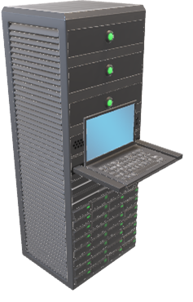


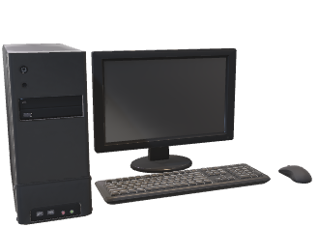


FRONTEND
BACKEND
Client
Internet
Web server
DB
Game server

